Slide 1


Master Degree in Computer Engineering
Compression of Sequencing Data for Phylogeny
Reconstruction
Supervisor: Prof. Matteo Comin
March 26, 2025
Master Candidate: Andrea Nicetto
Academic year 2024-2025

Slide 2
Project goals
Evaluate the impact of compression on sequencing reads, focusing on storage reduction and data integrity
Compare alignment-free phylogenetic methods on compressed and uncompressed data
Assess computational efficiency and phylogenetic accuracy, emphasizing execution time and tree similarity
2

Slide 3
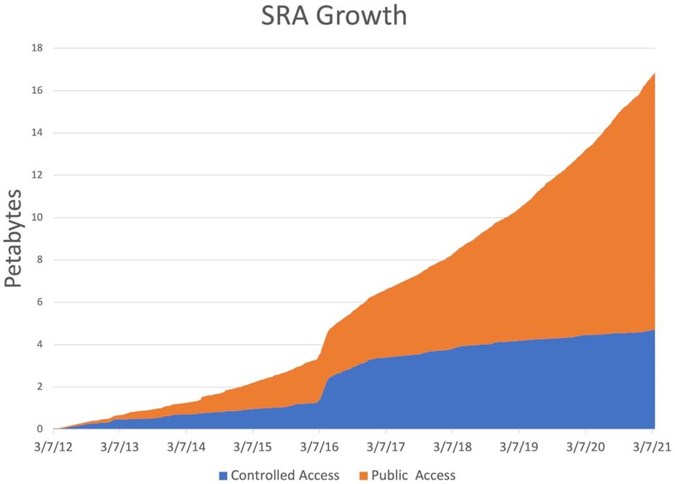
Sequencing Data Growth
3

Slide 4
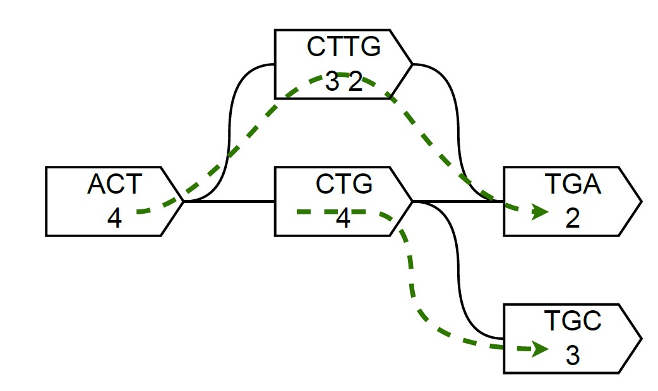
USTAR compression
USTAR compresses sequencing data by merging sequences in a compacted de Bruijn graph, reducing redundancy
It preserves the k-mer spectrum and its distribution, ensuring that the frequency and composition of k-mers remain unchanged
Generate:
ACTTGA
CTGC
4

Slide 5
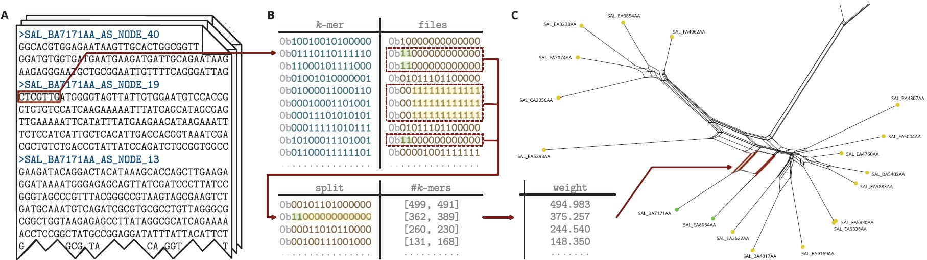
Phylogenetic reconstruction
phyBWT2 - Extended Burrows-Wheeler Transform
Mash - MinHash Sketching
SANS - Genome-Wide Split Analysis
5

Slide 6
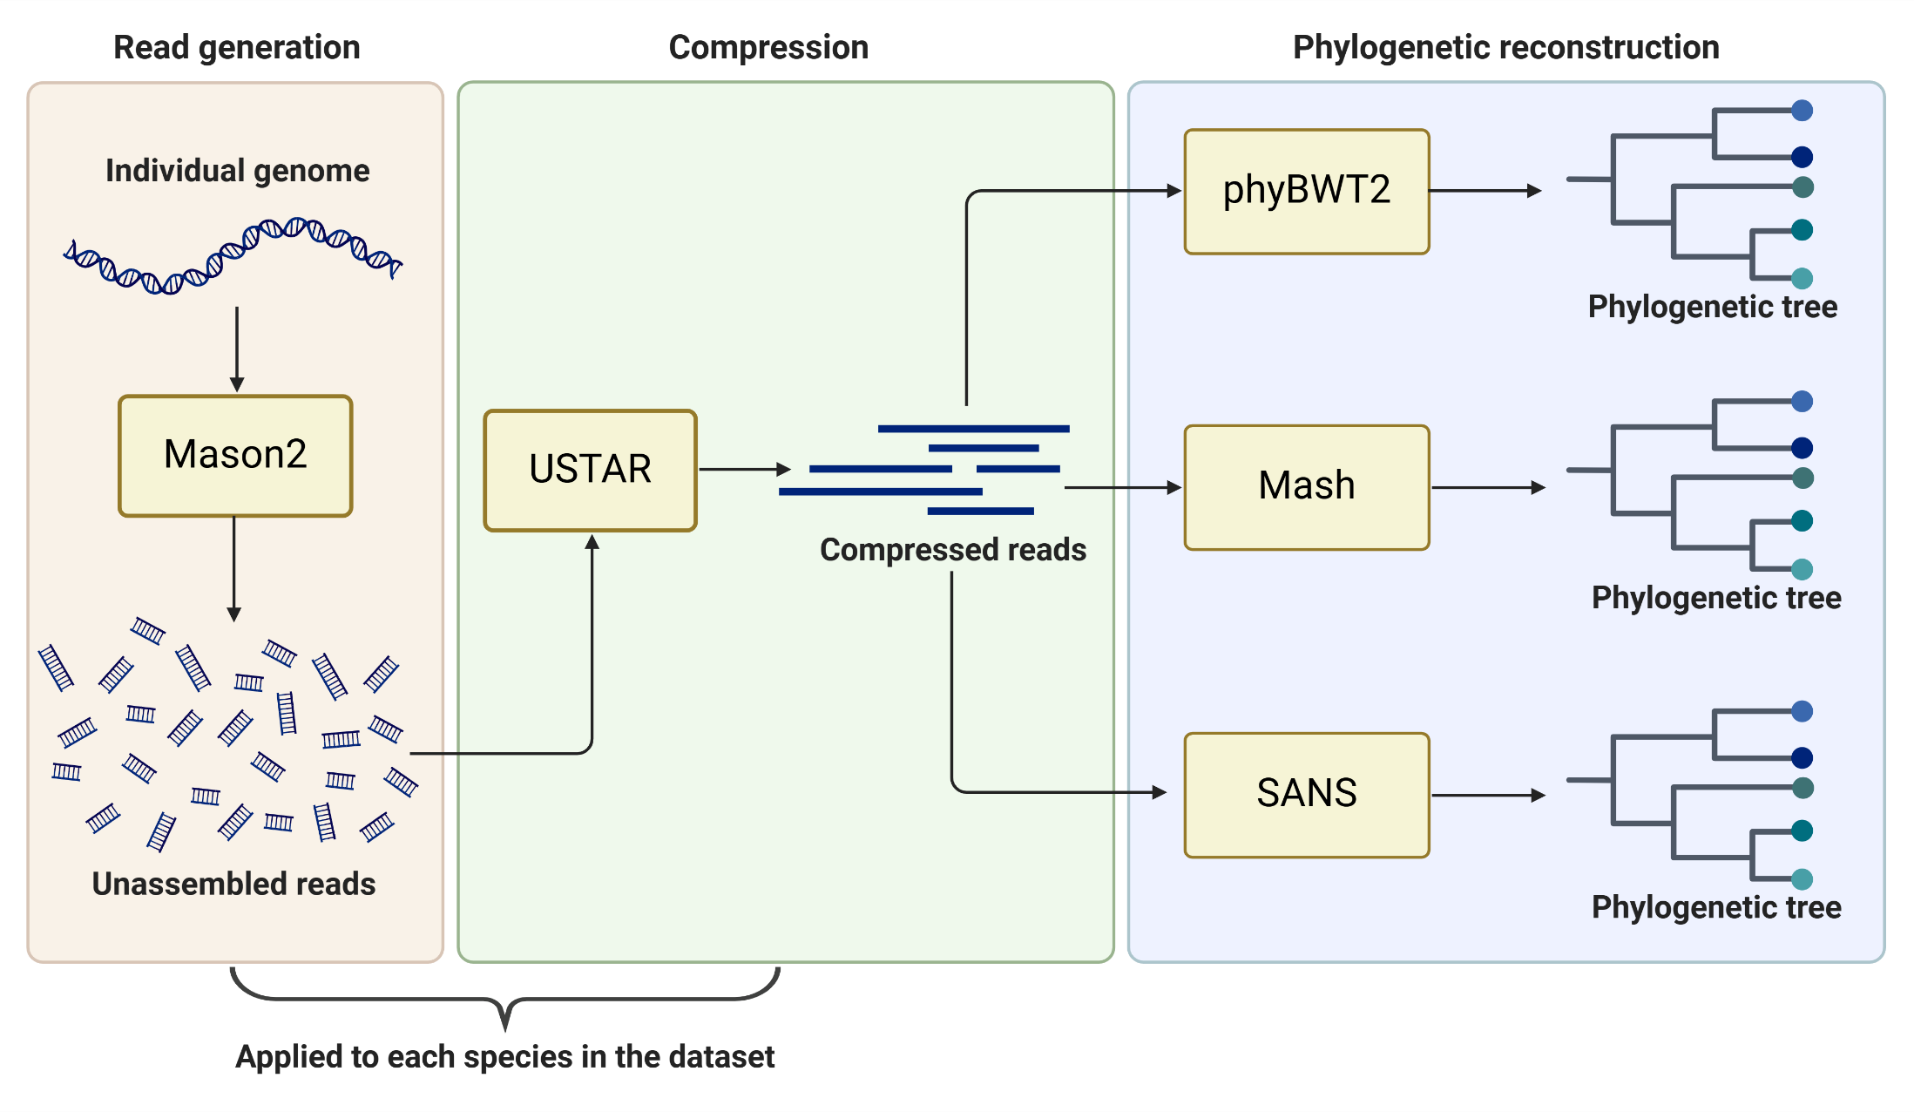
Pipeline Overview
6

Slide 7
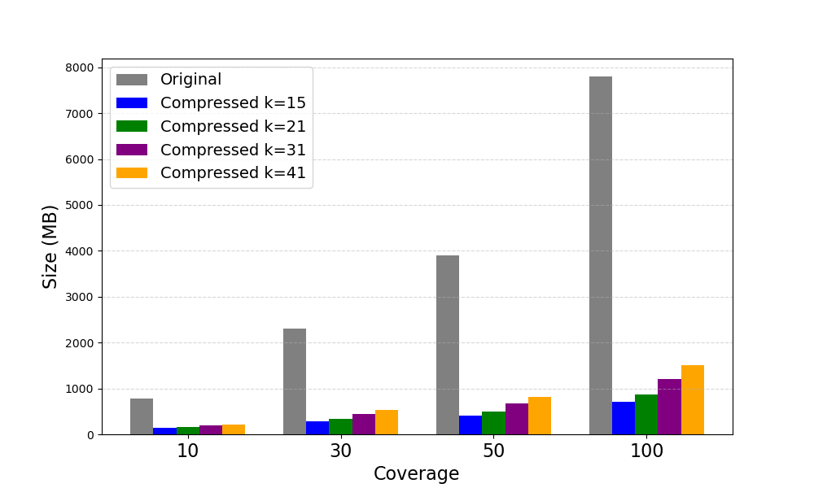
Data Compression
Simulated dataset size across different coverage levels and USTAR compression settings
7

Slide 8
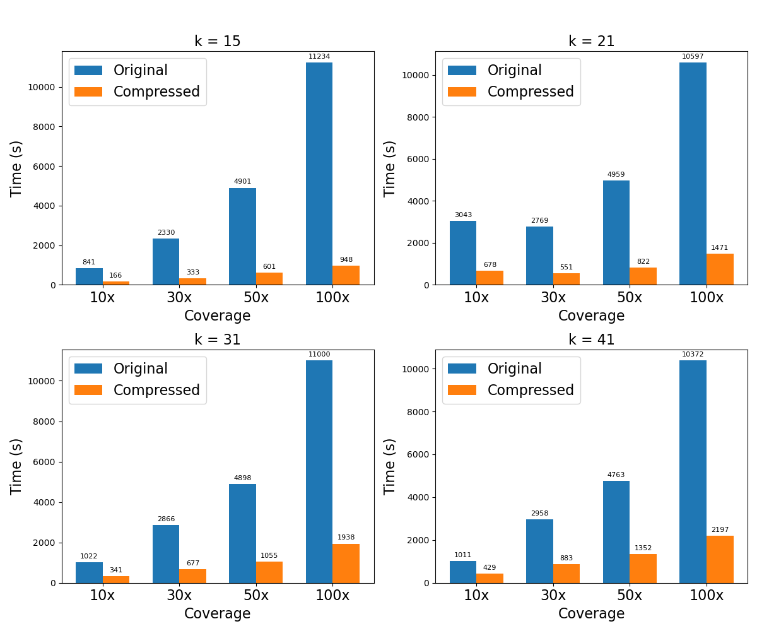
Execution Time
Execution times of phyBWT2 on the Simulated dataset at different compression levels
8

Slide 9
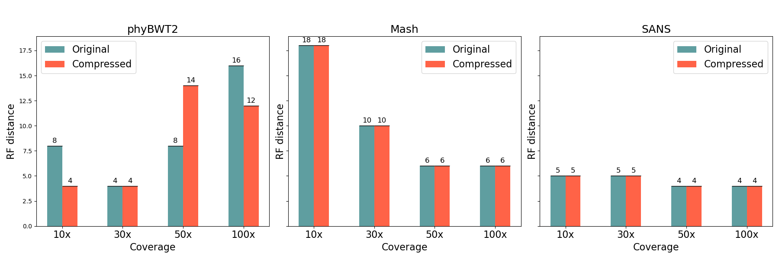
Phylogenetic accuracy
Robinson-Foulds distance on the Simulated dataset with USTAR compression at k-mer size equal to k=21
9

Slide 10
Conclusions
USTAR efficiently reduces dataset size, optimizing storage space
Compression reduces execution times while preserving the quality of the phylogenetic trees produced by the reconstruction software
10

Slide 11
Thanks for your attention!

Slide 12
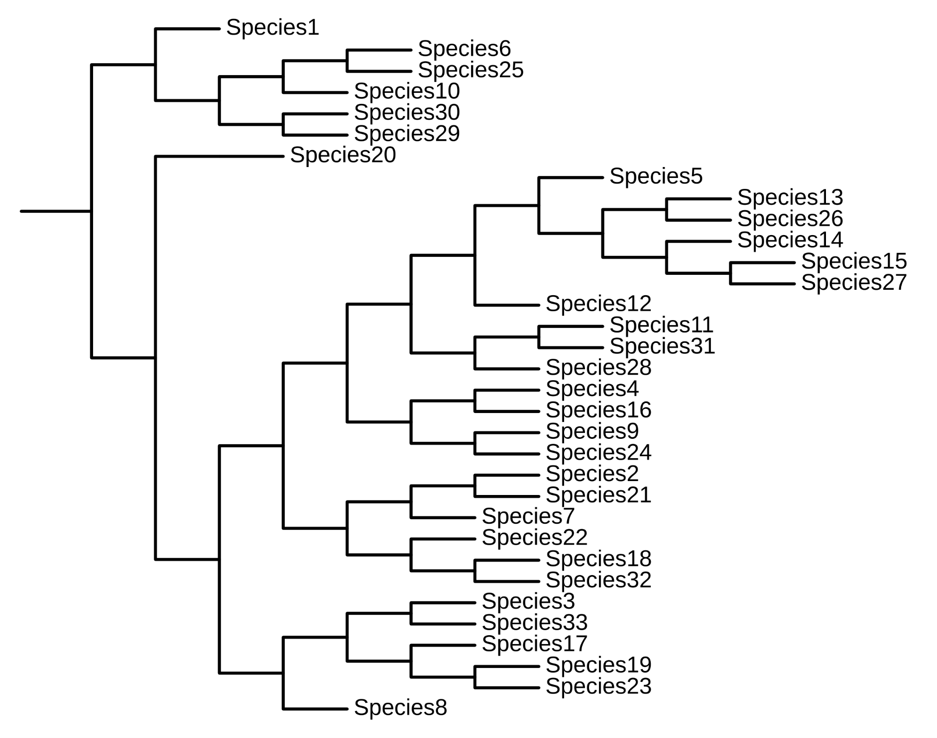
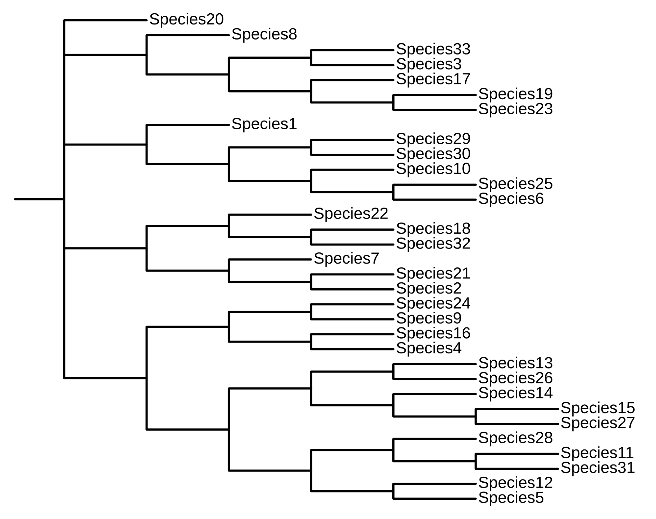
Extra

Slide 13
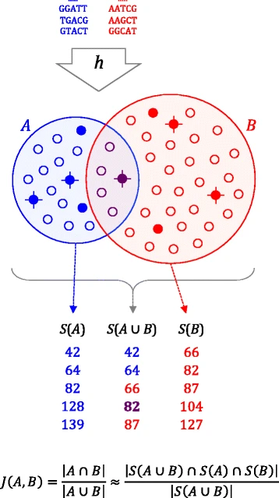
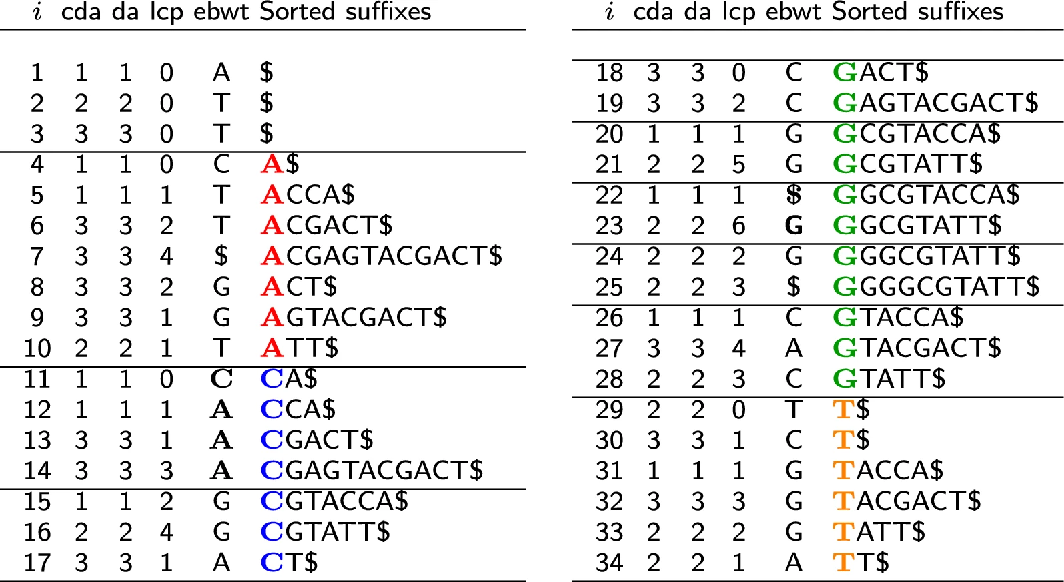
Extra
S={GGCGTACCA, ACGAGTACGACT, GGGGCGTATT}

Slide 14
Extra

